Slide 1

THE MEAN SQUARES
ANALYTICS IN BANKING
A BUSINESS ANALYTICS PROJECT PRESENTATION
PREPARED BY DANIEL BARRETT, EILEEN DZHUMASHEVA, ESHAN GAINDHAR, JACKY YANG, JEREMY FORBES AND LISA KOSHENKO

Slide 2
Why Use Analytics in Banking?
In the age of information, businesses are looking to do more and more with their information. We will look at how analytics is used in banking.
Motivation
Analysing customer data can help companies utilise resources in a more efficient manner in order to improve performance.
The banking sector in particular has realized the importance of this, and banks now enlist consultants to uncover consumer trends in collected data.
In this project, we have been given a data set of past marketing campaigns of a banking instruction, that contains customer and campaign characteristics. We’ll act as analysts to a banking institution.
Task Going Forward
Identify what type of customers are most likely to subscribe to a term deposit, thus roll out a new marketing campaign that is more efficient and effective.
A good predictive model will allow the bank to focus resources on obtaining the most interested customers, rather than using a blind, all-round approach that would involve calling up uninterested customers.

Slide 3
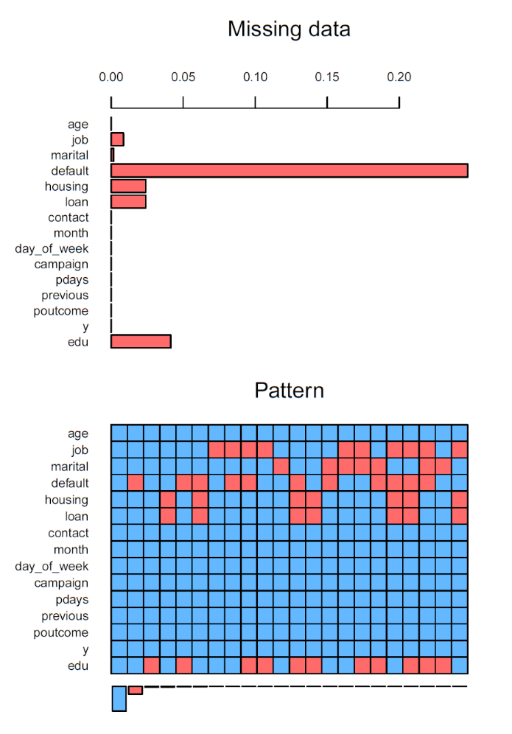
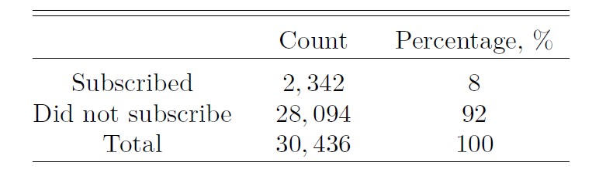
Description of the Data
We have been given phone call data to 30436 prospective clients.
Imbalanced Data
Illustrations of Missing Unknown Responses
Clients who subscribed to bank term deposits make up less than 10% of the training data.
Class imbalance problem - makes classification difficult because standard classifiers are driven by accuracy.
Missing Data
24% of observations are missing information.
Data appears to be not missing completely at random (NMCR).

Slide 4

Model Selection
The main candidate models we considered were logistic regression and random forest.
Classification Evaluation Metric
$$LogLoss= −\frac{1}{N}\sum_{i=1}^{n}{[y_{i}\log\left(\hat{p_{i}}\right)+(1−y_{i})}\log\left(1−\hat{p_{i}}\right)]$$
Candidate Models
Logit
1
Assume that the independent variables are related linearly through log-odds.
2
Does not impose any direct linear constraints on the relationship between our predictors and response.
Random Forest
1
Does not carry with it any strong assumptions.
2
However was computationally intensive and this was a minor drawback.
3
Allows us to capture highly complex, non-linear dependencies.

Slide 5
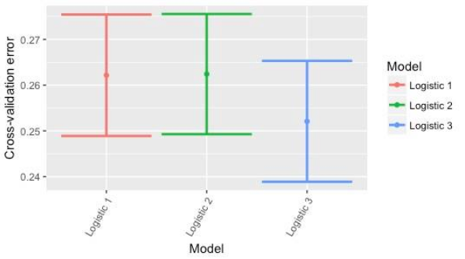
Variable Selection for Logistic Regression
Based on visualisations, we will include the following predictors: age, job, marital, default, loan, contact, campaign, pdays, poutcome, edu.
Model 1
Model 2
Model 3
Models log-odds as a linear combination of these variables.
Includes interactions between age & job, age & education, job & default, age & marital.
Uses a different best subset selection technique, the stepwise procedure. We run a stepwise regression both ways using step with direction = “backwards”.

Slide 6
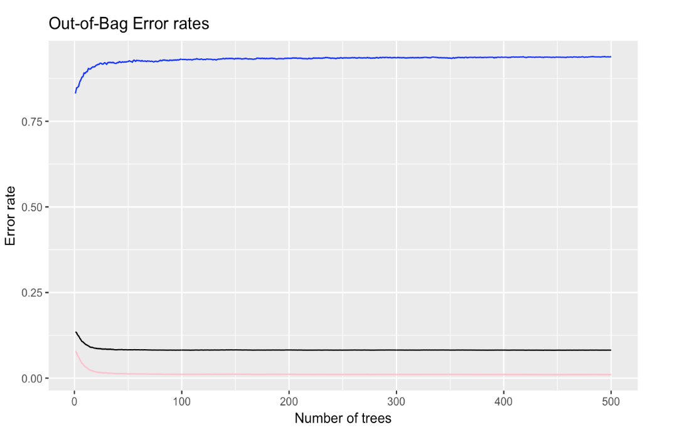
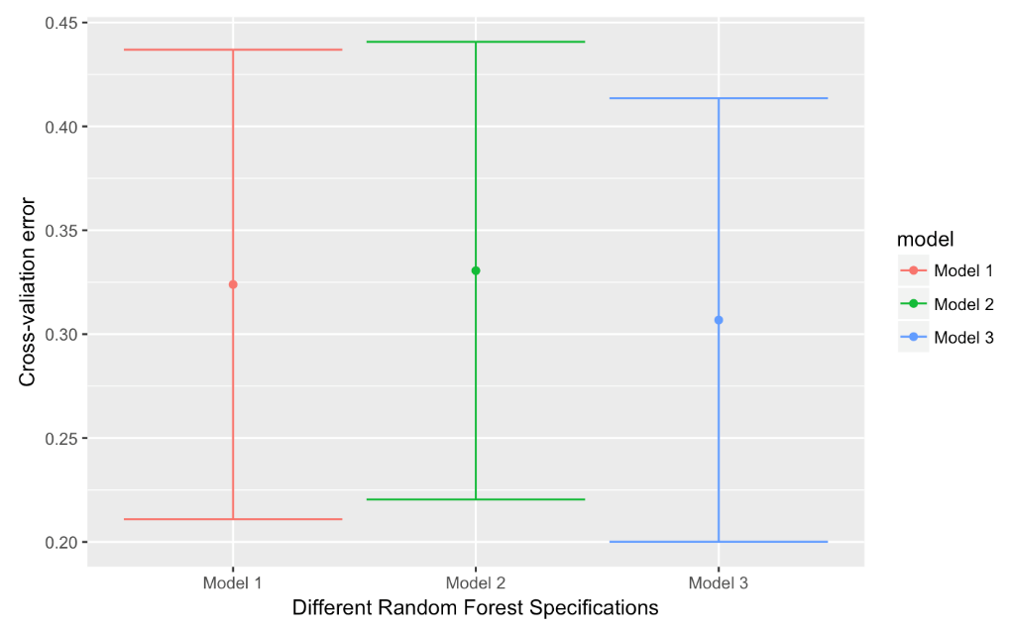
Random Forests
We briefly explored classification trees using all features as potential candidates for stratifying the sample space.
Out-of-Bag Error Rates
Results of 20-fold CV on Each of the Stated Models

Slide 7
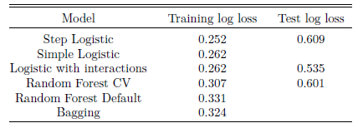
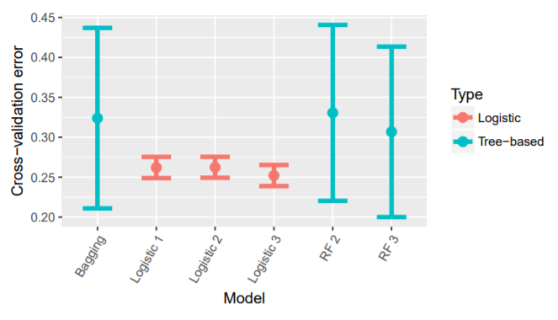
Results and Final Model
The logistic regression model appears to perform much better than the classification trees and random forest, based on our cross-validation (log loss) errors.
Discussion
Cross-validation Errors Comparison
Amongst the three-based candidates, random forest using mtry = 5, performed marginally best, with a CV log-loss of 0.3068.
Each of the logistic regression models outperform all the tree-based candidates, and the logistic models are within one standard error of the lowest cross-validation error.
We are therefore justified in choosing the simplest of the three.
Our Final Model
The stepwise regression is the simplest model, containing 9 out of a possible 14 predictors in our training set. We’ve selected this model.
lm(formula = y ~ age + job + default + contact + month + day_of_week + campaign + pdays + previous, family = binomial, data = train)

Slide 8
Performance on the Test Set and Conclusions
Our conclusions on model preference, based on cross-validation, do not match the corresponding test performance. We suspect that this is caused by discrepancies between test and training data sets.
Model Performance on Kaggle
Caveats and Improvements
1
Stepwise logit did not perform as we expected.
1
The curse of learning from an extremely imbalanced training data set affects both logistic regression and random forest.
2
RF-CV model trumped the stepwise logit, scoring a 0.008 lower log-loss.
2
Oversampling techniques to deal with the significant class imbalance.
3
Logistic models with the reduced variable set performed much better. The logit model with interactions performed the best.
3
There are opportunities to model using higher values of K using the KNN technique, and using LDA and QDA.

